Slide 1



3D Reconstruction from multiple 2d images without camera calibration
Autor Stefano Di Patti
Advisor Prof Arno Formella, Filippo Stanco
A.A. 2020/2021
Università degli Studi di Catania
Dipartimento di Matematica e Informatica
Corso di laurea in Informatica

Slide 2

Computer vision
Computer vision is an interdisciplinary field of study of Computer Science that deals with understanding how computers can reproduce processes and functions of the human visual apparatus.
The most ambitious challenge of computer vision nowadays concerns the high level vision, that means from the 2D image being able to process, reconstruct and analyze the entire 3D context in which the image is inserted.

Slide 3
3D RECONSTRUCTION
3D reconstruction is the process of capturing the shape and appearance of real objects. It is a generally scientific problem and core technology of a wide variety of fields, such as computer animation, medical imaging, virtual reality etc.
Active methods use a numerical approximation approach and build the object in scenario based on model by interfering mechanically or radiometrically on it.
Passive methods use common image sensors and use the light reflected or emitted by the object to infer its 3D structure through image understanding.

Slide 4
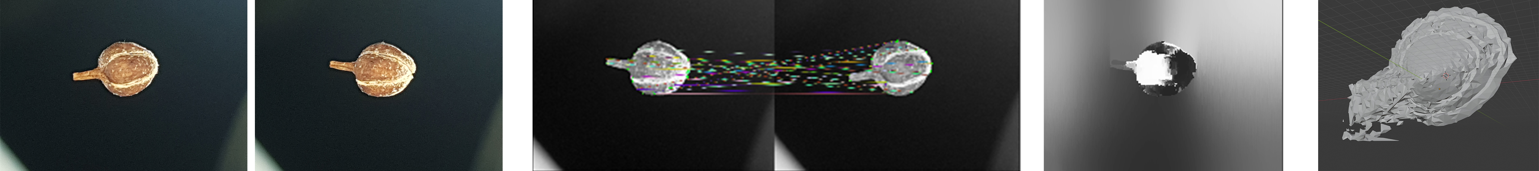
USED APPROACHES
Multiview 3D reconstruction is to infer geometrical structure of a scene captured by a collection of images. By using multiple images, 3D information can be (partially) recovered by solving a pixel-wise correspondence problem.
Structure From Motion (SFM) is generally used to structure images.
Multi view stereo (MVS) takes this location and orientation etc information from SFM and make a 3D dense point cloud. Using a multiview stereovision system, images can be taken:
by using multiple cameras at fixed angles
by using single camera and varying the angles.

Slide 5
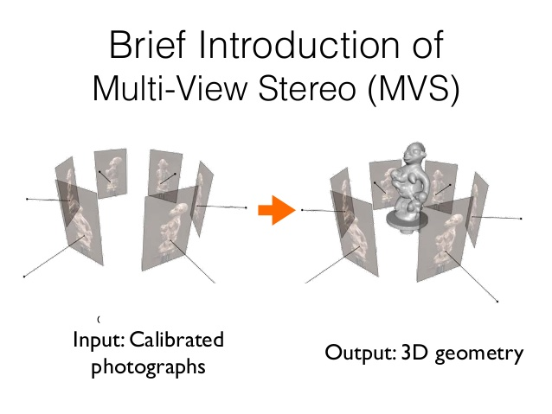
USED APPROACHES
Imaged-Based methods use different approaches of analyzing the images to understand the 3D shape of the object:
the 2D characteristics (e.g. Silhouettes, shading and texture);
- Lambertian reflectance or lightning conditions;
- Distortion and perspective;
- Research of human visual system;
The output is usually a depth map that represents the third-axis missing information from an estimated viewpoint.

Slide 6

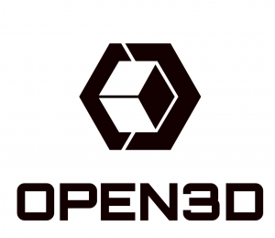

PYTHON, OPENCV & OPEN3D

Slide 7
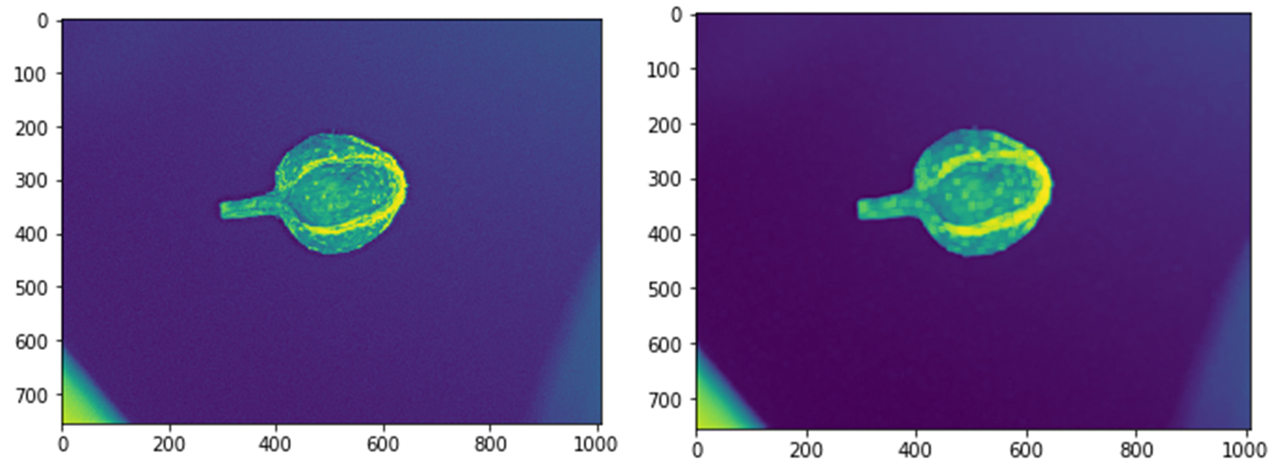
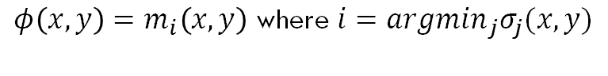
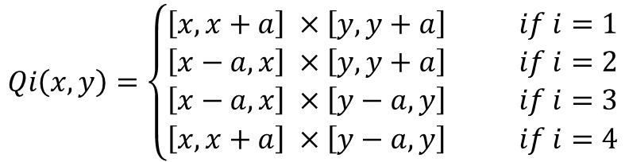
NOISE REDUCTION
Kuwahara filter is used for noise reduction, it is a non-linear smoothing filter with the particularity that it preserves edges.
A square window of size 2a+1 is centered around an xy point in the image. The square is subdived into four smaller regions:
The arithmetic mean and standard deviation of the four regions centered around a pixel (x,y) are established to determine the value of the central pixel.
The output of the Kuwahara filter for any point (x,y) is then given by:
$$Qi\left(x,y\right)=\left\{\begin{aligned}\left[x,x+a\right] ×\left[y,y+a\right] if i=1 \\ \left[x−a,x\right] ×\left[y,y+a\right] if i=2 \\ \left[x−a,x\right] ×\left[y−a,y\right] if i=3 \\ \left[x,x+a\right] ×\left[y−a,y\right] if i=4\end{aligned}\right.$$
$$φ\left(x,y\right)=m_{i}\left(x,y\right) \text{where} i={argmin}_{j}σ_{j}(x,y)$$

Slide 8
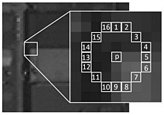
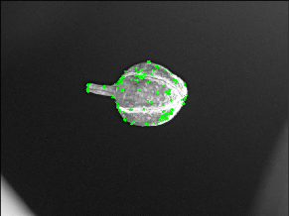
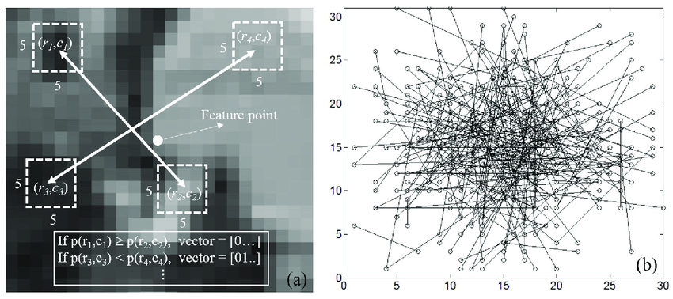
FEATURE DETECTION (ORB)
ORB uses FAST keypoint detector and BRIEF descriptor with many modifications to increase the performance.

Slide 9
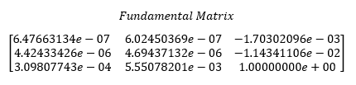
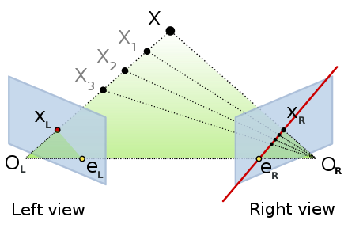
EPIPOLAR GEOMETRY
The epipolar geometry is the intrinsic projective geometry between two views. It is independent of scene structure, and only depends on the cameras’ internal parameters and relative pose. The geometric entities involved in epipolar geometry are:
The epipole: the point of intersection of the line joining the camera centres (the baseline) with the image plane.
An epipolar plane is a plane containing the baseline.
An epipolar line is the intersection of an epipolar plane with the image plane. All epipolar lines intersect at the epipole.
The fundamental matrix is the algebraic representation of epipolar geometry. It is a 3×3 matrix which relates corresponding points in stereo images.

Slide 10
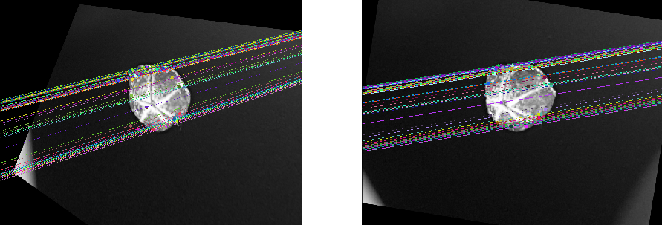
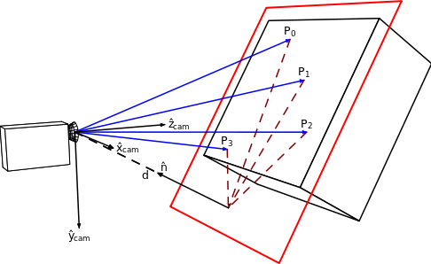
HOMOGRAPHY & RECTIFICATION
In the field of computer vision, any two images of the same planar surface in space are related by a homography (assuming a pinhole camera model that is also our case of study).
A Homography is a transformation (a 3×3 matrix) that maps the points in one image to the corresponding points in the other image.
Image stereo-rectification is the process by which two images of the same solid scene undergo homographic transforms, so that their corresponding epipolar lines coincide and become parallel to the x-axis of image.

Slide 11
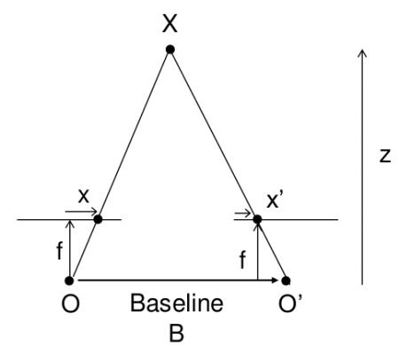
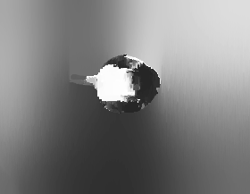
DEPTH MAP
A depth map is an image or image channel that contains information relating to the distance of the surfaces of scene objects from a viewpoint.
The StereoSGBM class implements the modified H. Hirschmuller algorithm. A Weighted Least Squares Filter is applied according to the use of left-right-consistency-based confidence to refine the results.
A simpler Birchfield-Tomasi sub-pixel metric from is used. Some pre- and post- processing steps are included.

Slide 12
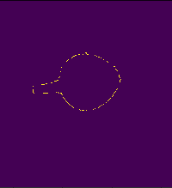
CANNY EDGE DETECTOR
The Canny edge detector is an edge detection operator that uses a multi-stage algorithm to detect a wide range of edges in images.
First step is to remove the noise in the image with a 5x5 Gaussian filter.
Smoothened image is then filtered with a Sobel kernel in both horizontal and vertical direction to get first derivative in horizontal direction and vertical direction. From these two images, we can find edge gradient and direction for each pixel. Gradient direction is always perpendicular to edges.
At every pixel, pixel is checked if it is a local maximum in its neighborhood in the direction of gradient.
We need two threshold values, minVal and maxVal. Any edges with intensity gradient more than maxVal are sure to be edges and those below minVal are sure to be non-edges, so discarded.
After Edge Detection, countours are determined and sorted.

Slide 13
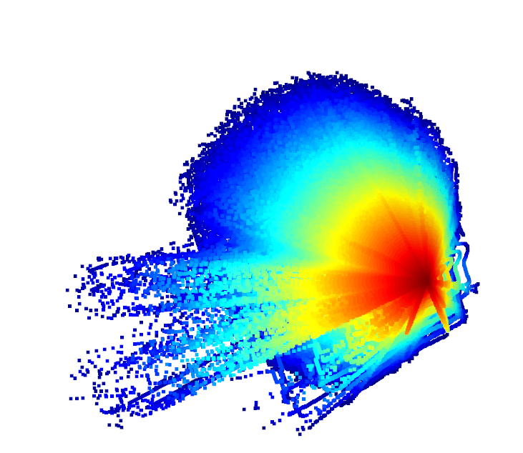
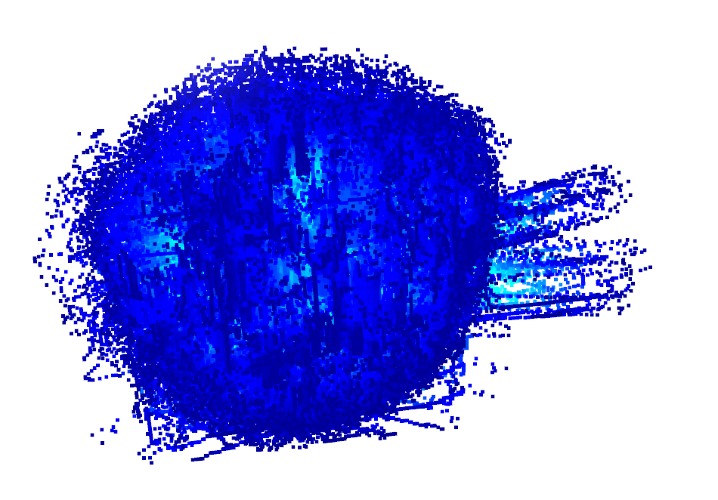
CREATE CLOUD POINTS WITH BACK-PROJECTION
3D points are mapped to the image plane (u, v) = f(X, Y, Z). The complete mathematical model that describes this transformation can be written as p = K[R|t] * P.
where
p, [u’, v’, z’] the projected point on image plane in pixel coordinate;
K is the camera intrinsics matrix;
[R|t] is the extrinsic parameters describing the relative transformation of the point in the world frame to the camera frame;
P, [X, Y, Z, 1] represents the 3D point expressed in Euclidean coordinate system;
aspect ratio scaling, s: controls how pixels are scaled in the x and y direction as focal length changes.

Slide 14
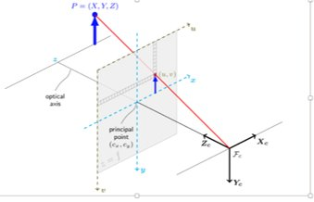
CREATE CLOUD POINTS WITH BACK-PROJECTION
The matrix K is responsible for projecting 3D points to image plane. To do that, the following quantities must be defined as:
focal length (fx, fy): Measure the position of the image plane to the camera centre.
principal point (u0, v0): The optical centre of the image plane.
skew factor: The misalignment from a square pixel if the image plane axes are not perpendicular. In our example, this is set to zero.
To estimate the 3D points:
Find the inverse of K
Apply equation with Z as depth from a depth map.
Using Linear Algebra:
cam_coords = K_inv @ pixel_coords * depth.flatten()
The @ (at) operator is intended to be used for matrix multiplication.

Slide 15
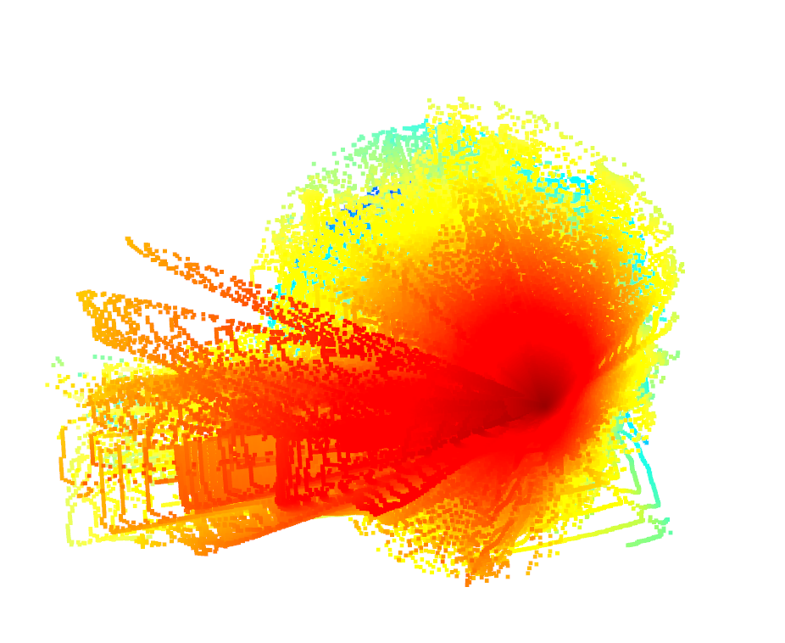
MULTIWAY REGISTRATION
Multiway registration is the process to align multiple pieces of geometry in a global space
Open3D implements multiway registration via pose graph optimization. A pose graph has two key elements: nodes and edges.
The neighboring nodes usually have large overlap and can be registered with Point-to-plane ICP (Iterative Closest Point) registration algorithm.

Slide 16
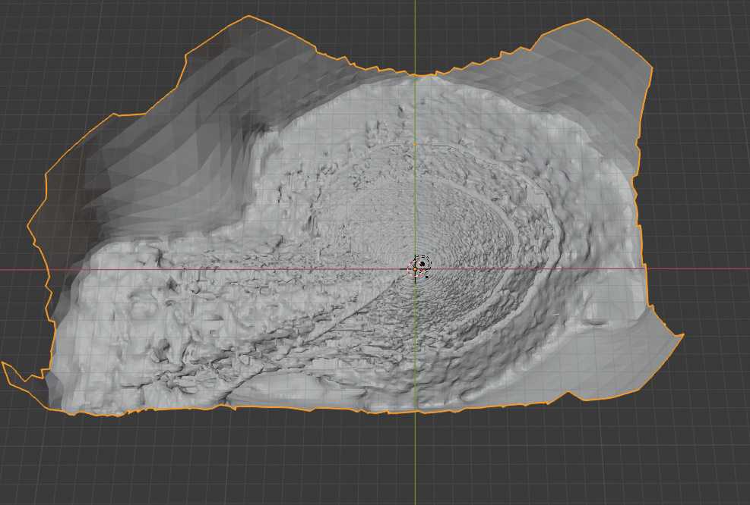
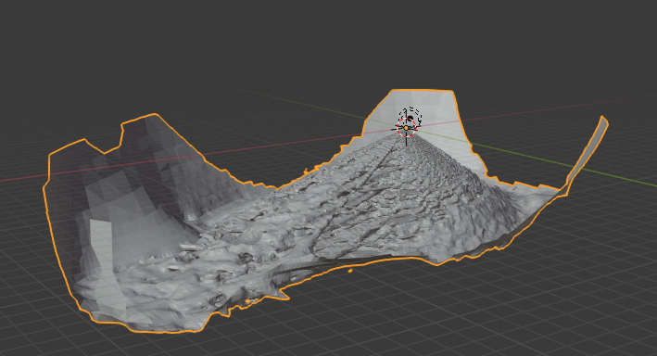
TRIANGLE MESH WITH POISSON
Surface reconstruction is an inverse problem and it is performed using a distance function which assigns to each point in the space a signed distance to the surface.
Points with the oriented normals are taken and the gradient of the indicator function is approximated through the normalfield.
The indicator function is derived from this gradient and the surface of the object can be extracted with the “marching cubes algorithm” to build an octree data structure for the representation of the surface.
The obtained point cloud is subdivided into a voxel grid by marching through the point cloud and analyzing which points define the isosurface of our object.
By detecting which egdes of the voxel are intersected by the model’s isosurface the algorithm creates the triangles of the mesh.

Slide 17
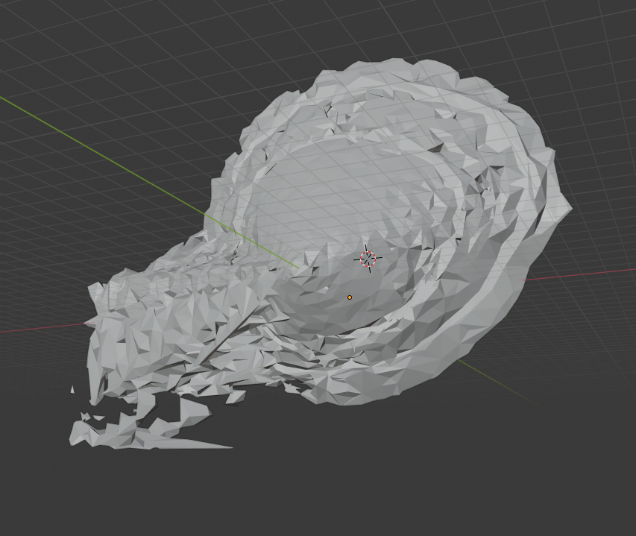
CONCLUSIONS
Comparing it with a standard approach based on camera calibration we can assert that the algorithm discussed in this paper is more complex computationally speaking, since it uses a lot of calculations to compensate the absence of camera calibration. Especially computing all those images between them to get more information about the 3D shape of the object and trying to rectify and fix them from their distorsion is very expensive.
Future directions:
Texture Mapping.
Algorithm Improvements.
Point Cloud.
Segmentation.

Slide 18

THANKS FOR YOUR ATTENTION

